Slide 1
Particle Camera on Board an Airplane
Jiri Kvita
Joint Laboratory of Optics
Faculty of Science
Palacky University Olomouc
2023–2024

Slide 2

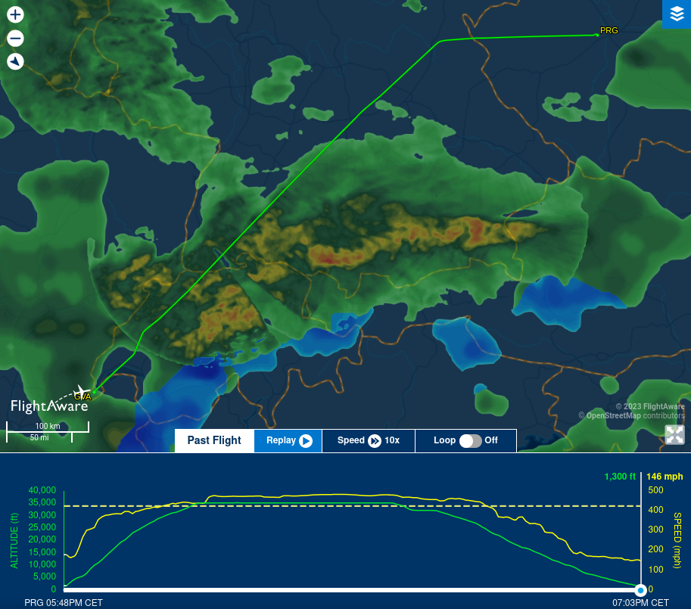
November 12th 2023
Easyjet flight EZS1564 12.11.2023 17:25 PRG–GVA

Slide 3
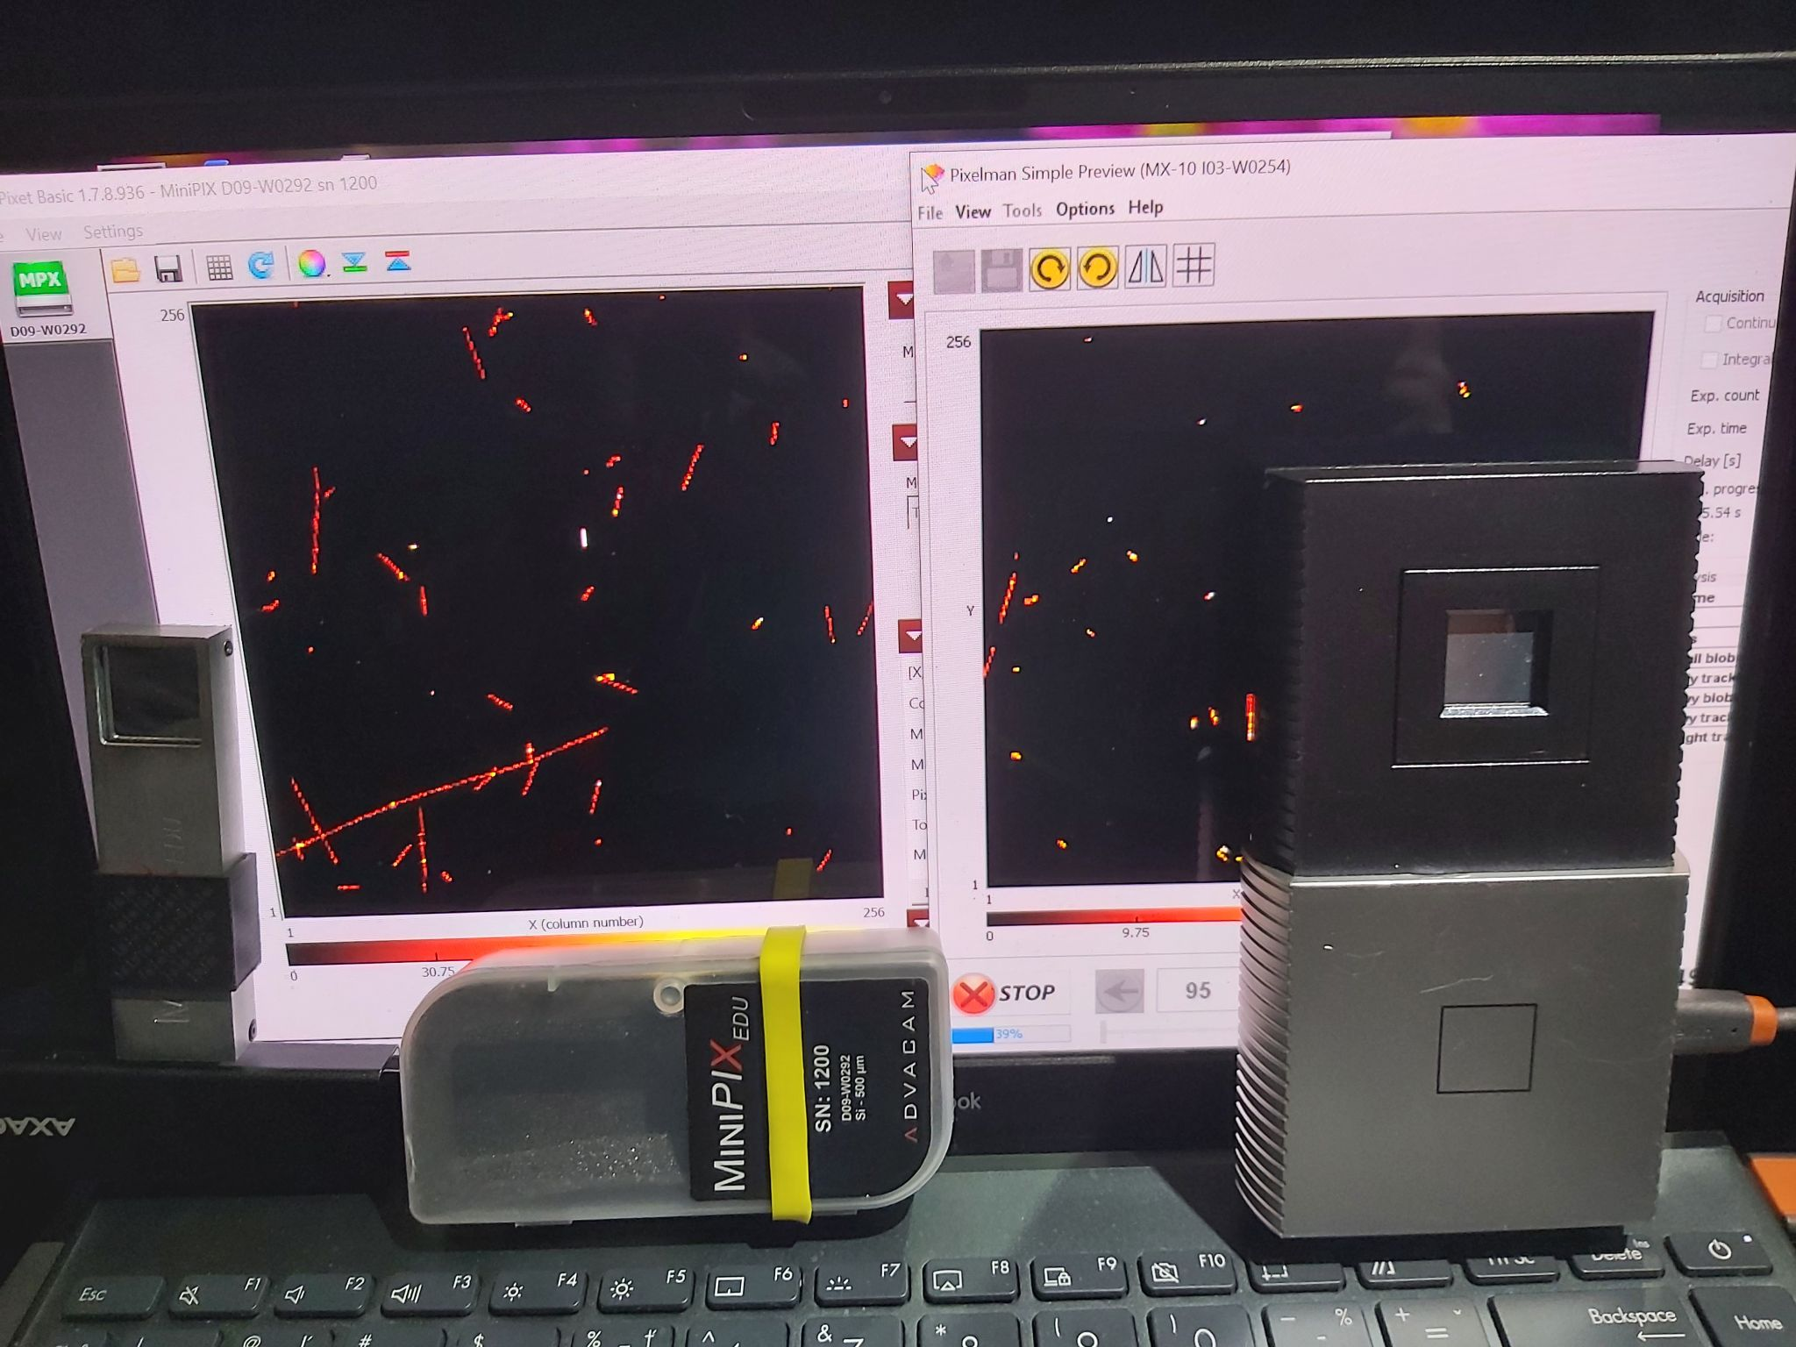
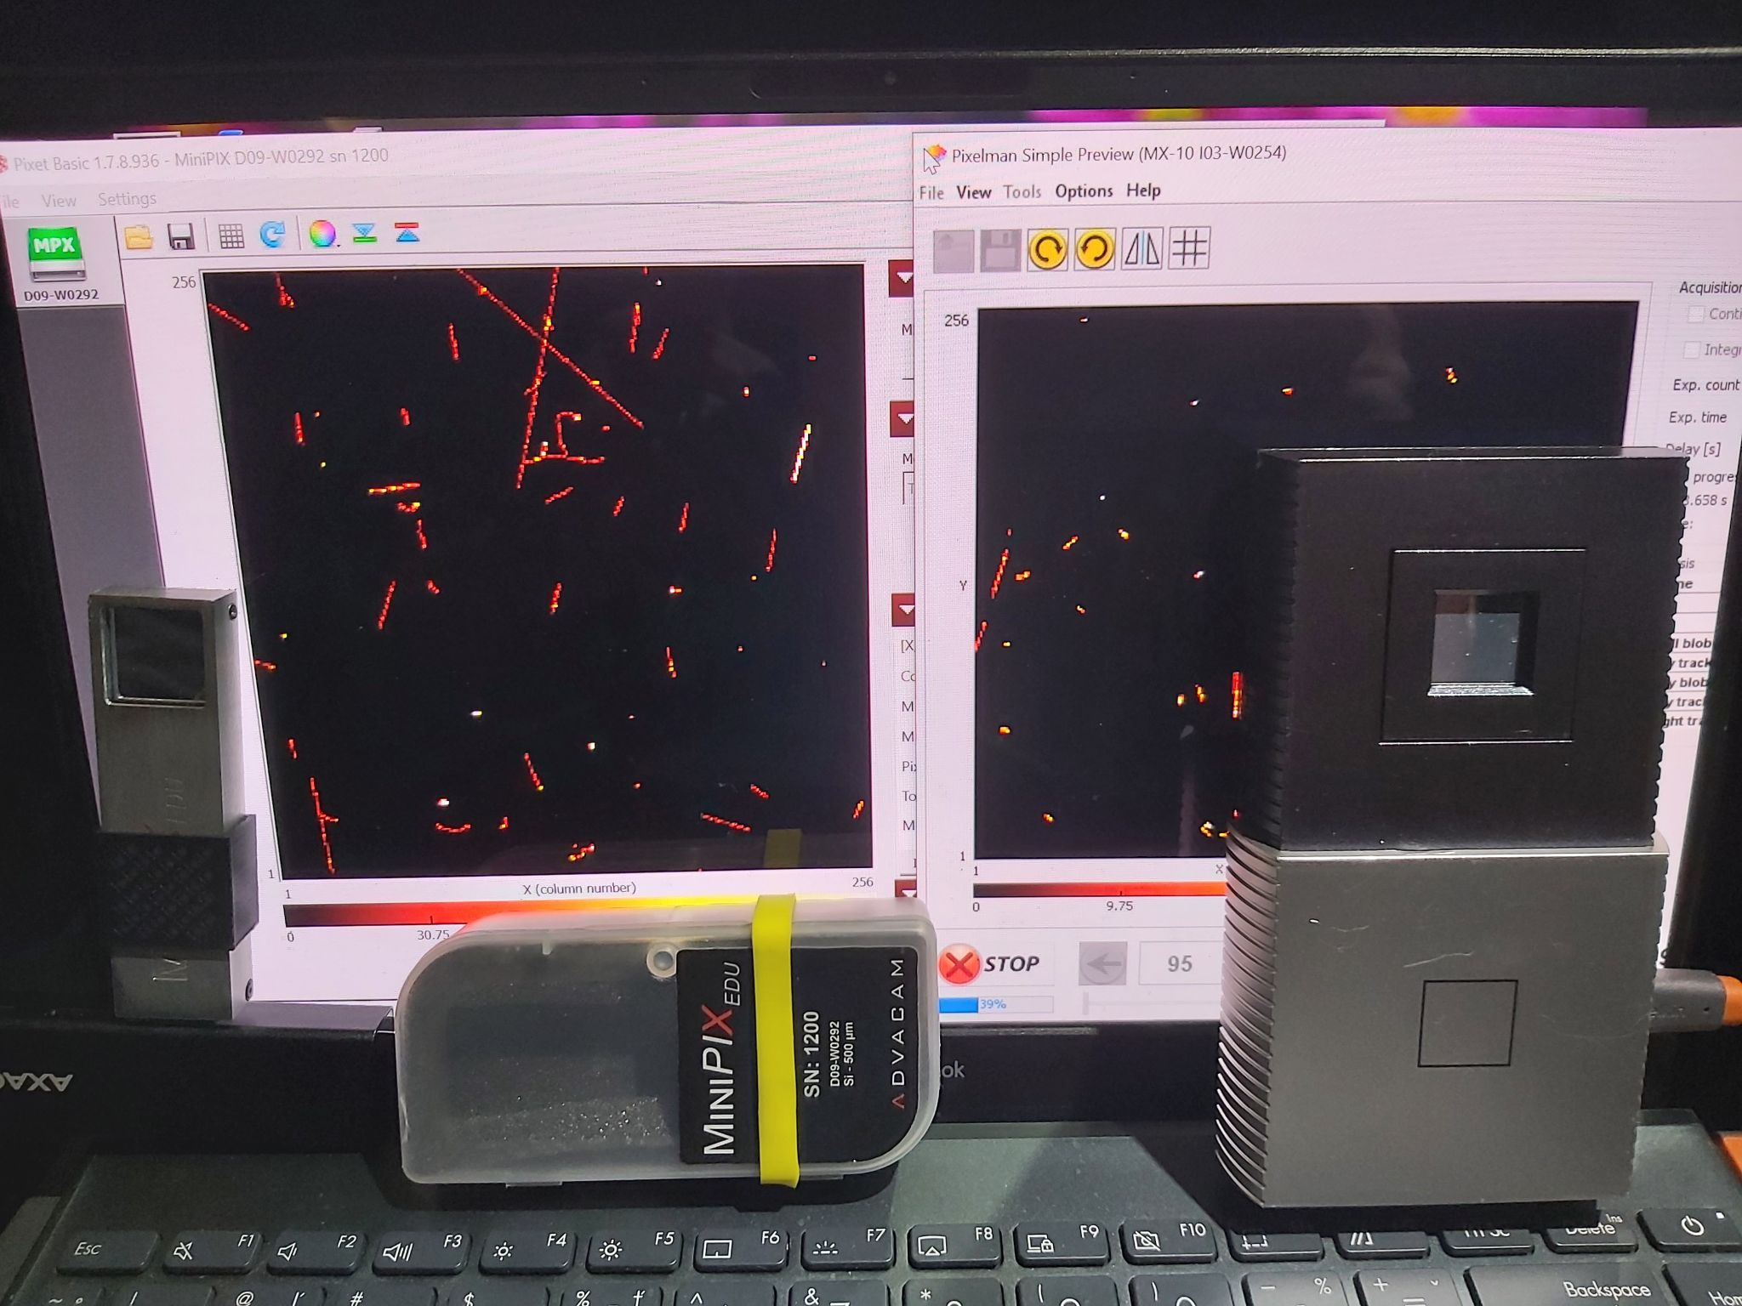
November 12th 2023
Easyjet flight EZS1564 12.11.2023 17:25 PRG–GVA

Slide 4
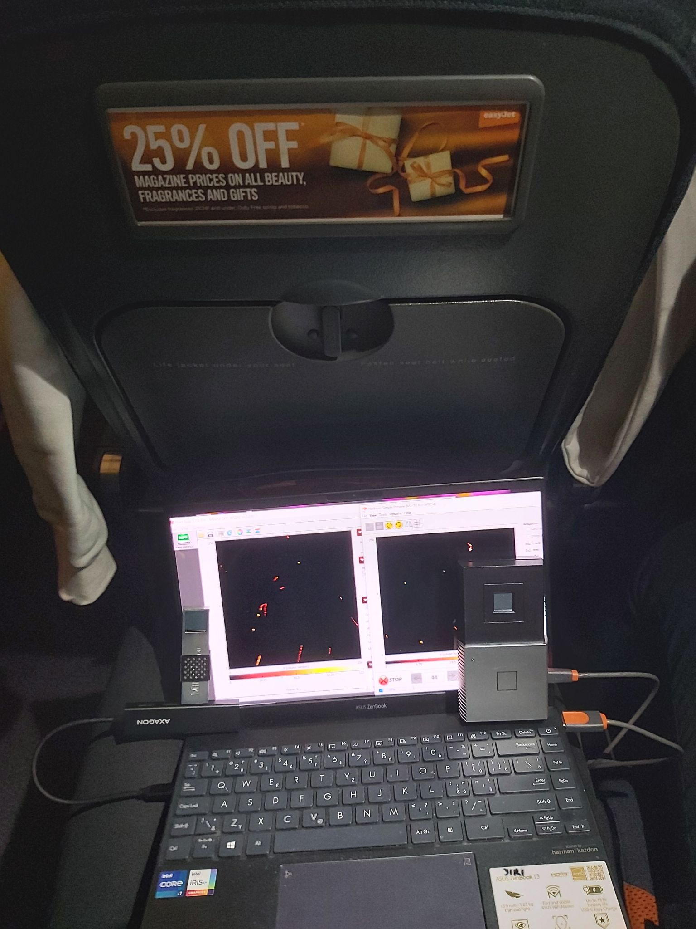
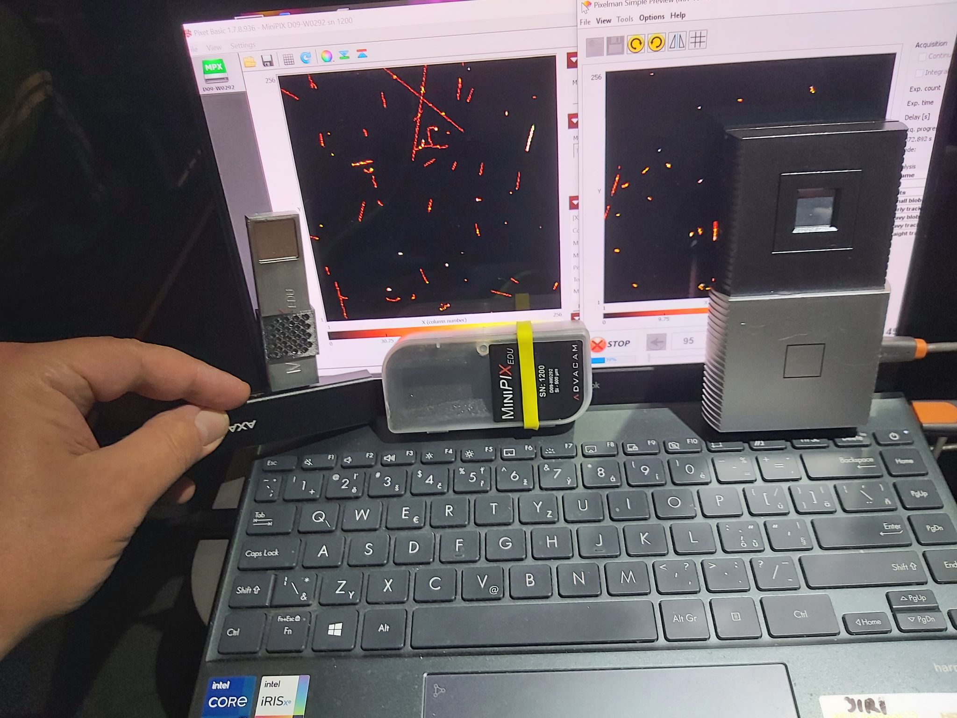
November 12th 2023
Easyjet flight EZS1564 12.11.2023 17:25 PRG–GVA

Slide 5
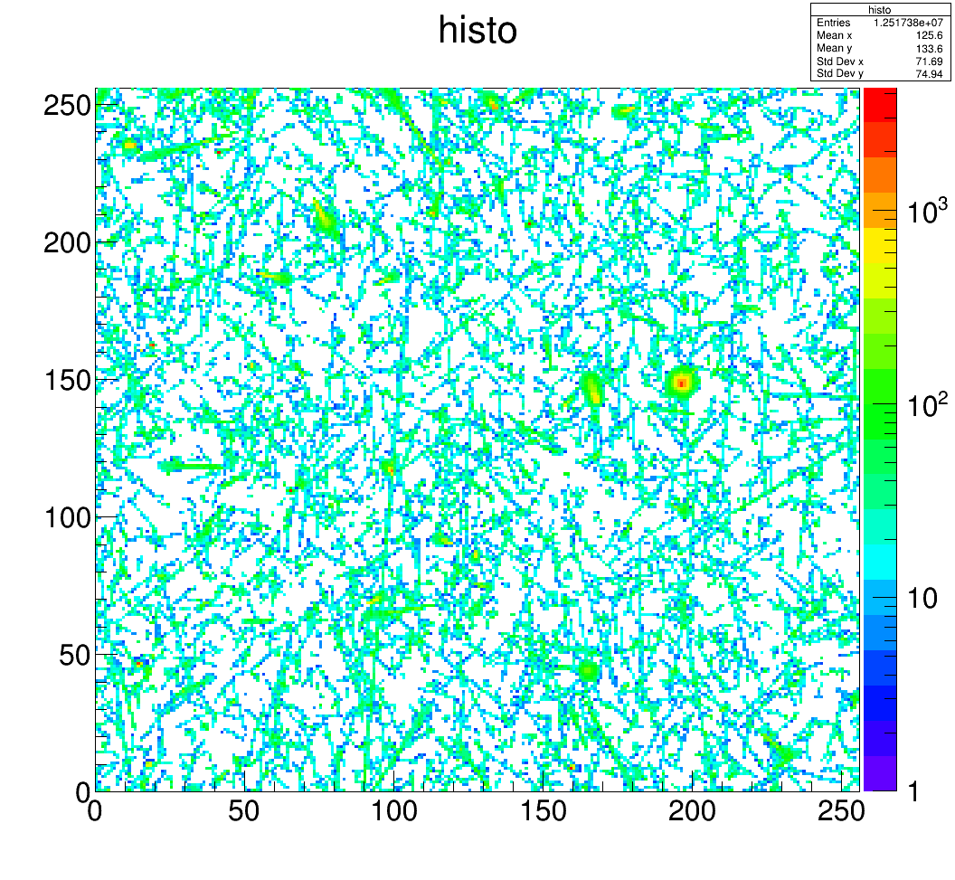
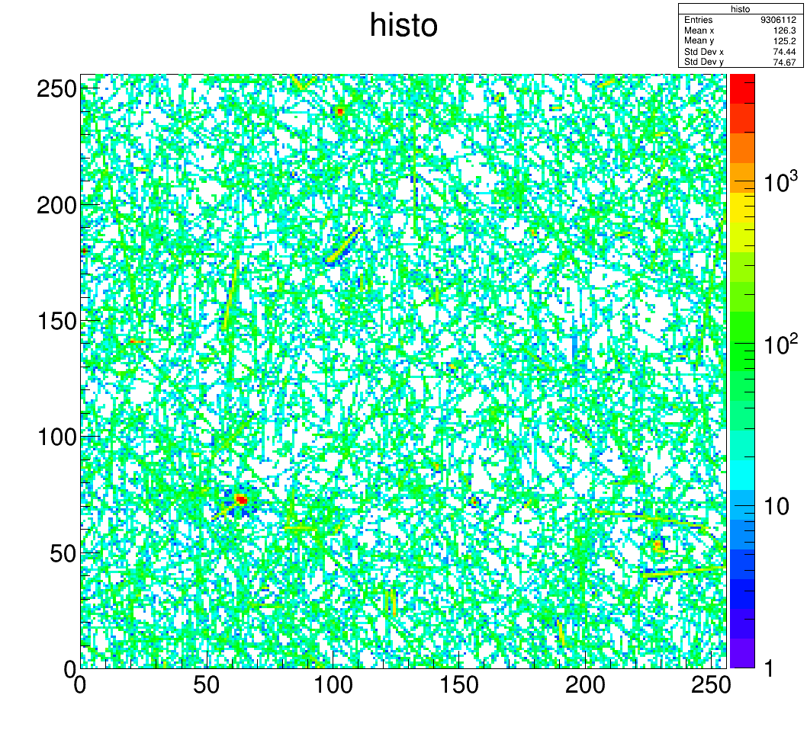
November 12th 2023
MX-10 t=300𝜇m, 191x30s, also ground
Advacam t=500𝜇m, 142x30s

Slide 6
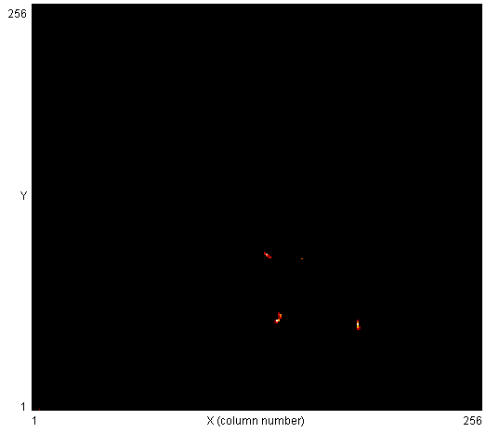
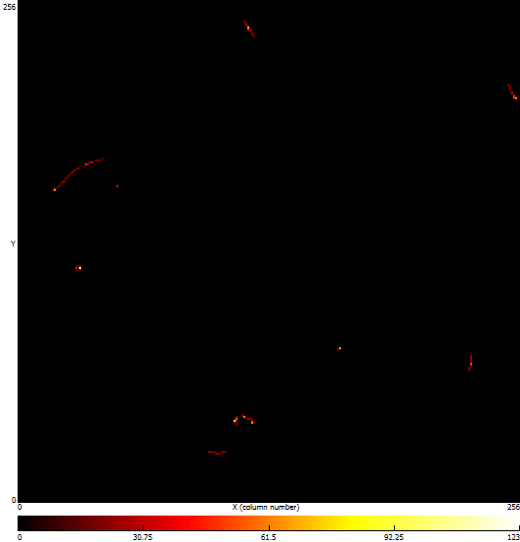
November 12th 2023
MX-10 t=300𝜇m, 191x30s, also ground
Advacam t=500𝜇m, 142x30s

Slide 7
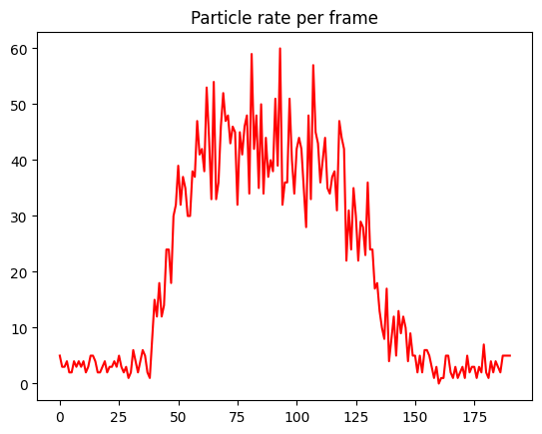
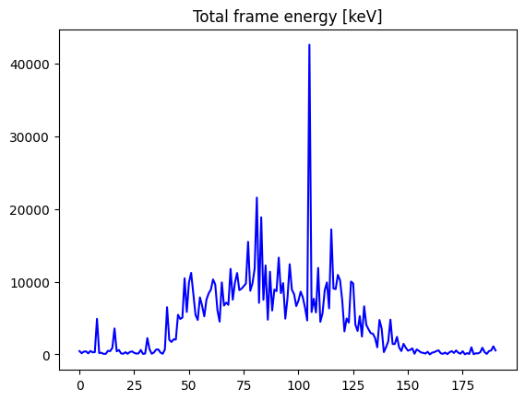
November 12th 2023
MX-10 t=300𝜇m, 191x30s, also ground
Particle rate as function of frame ID
Frame total energy in keV: maximum of 42.6MeV!

Slide 8
November 12th 2023
MX-10 t=300𝜇m, 191x30s, also ground
Particle rate as function of frame ID
Altitude as a green curve from https://www.flightaware.com

Slide 9
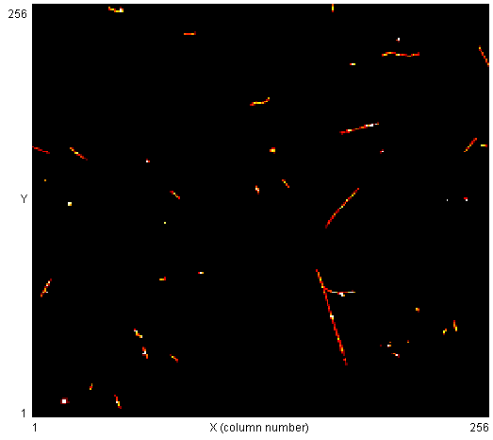
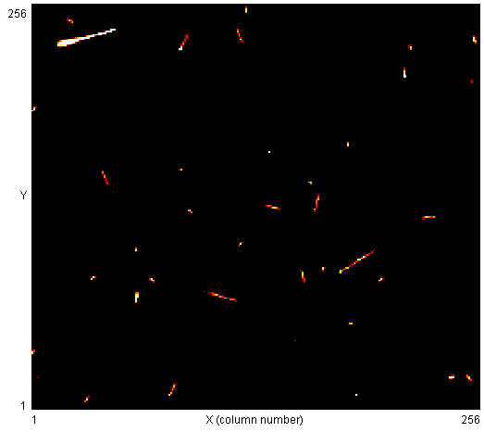
November 12th 2023
MX-10 t=300𝜇m
Delta electron
Heavy ionizing particle

Slide 10
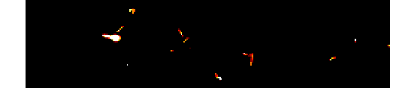
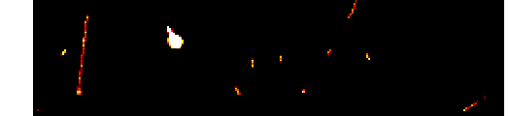
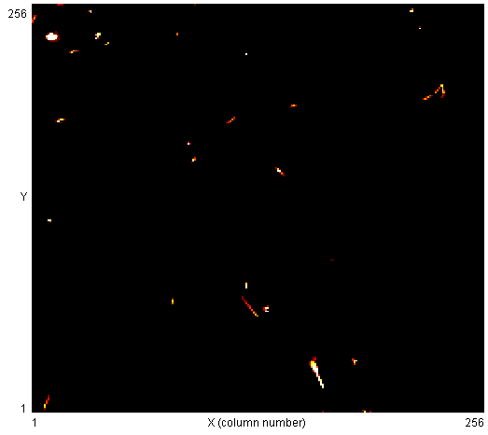
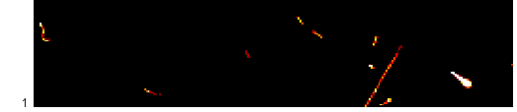
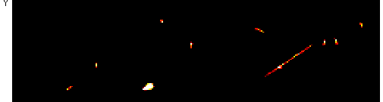
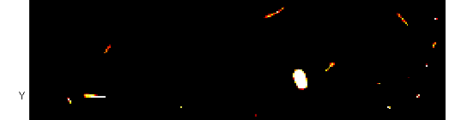
November 12th 2023
MX-10 t=300𝜇m
Heavy ionizing particles

Slide 11
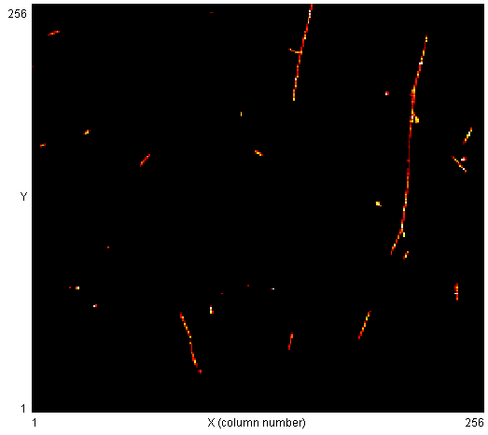
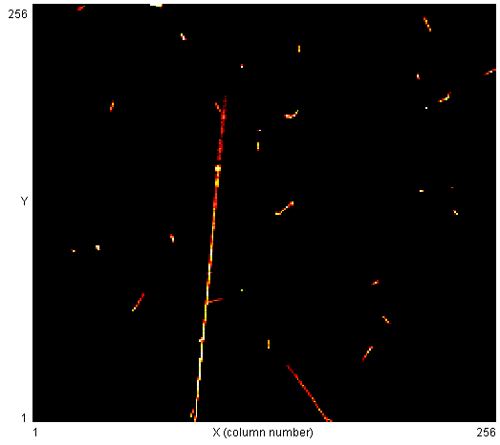
November 12th 2023
MX-10 t=300𝜇m
Muon multiple scattering
Possibly a pion

Slide 12
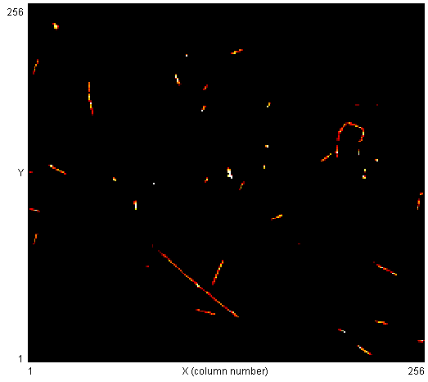
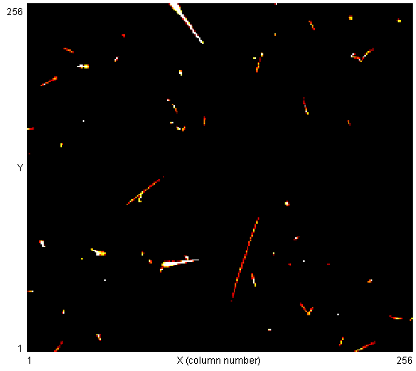
November 12th 2023
MX-10 t=300𝜇m
Low energy electron
Heavy ionizing particles

Slide 13
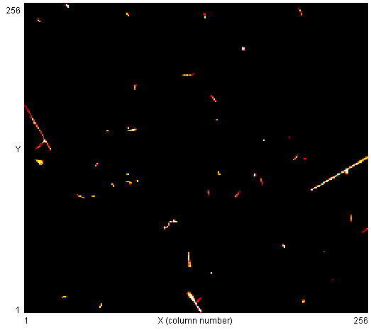
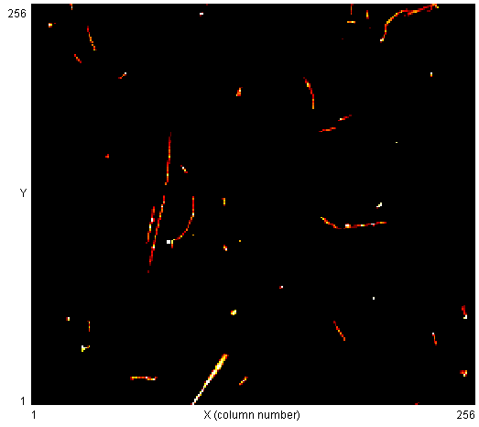
November 12th 2023
MX-10 t=300𝜇m
Heavy ionizing particles

Slide 14
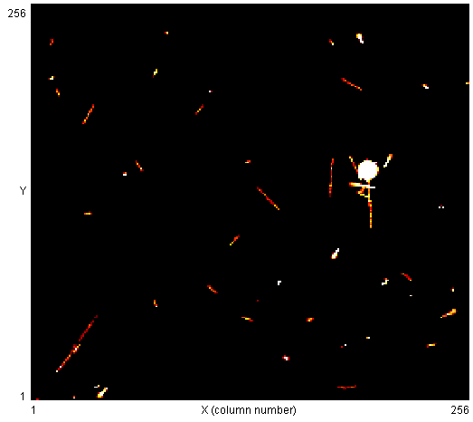
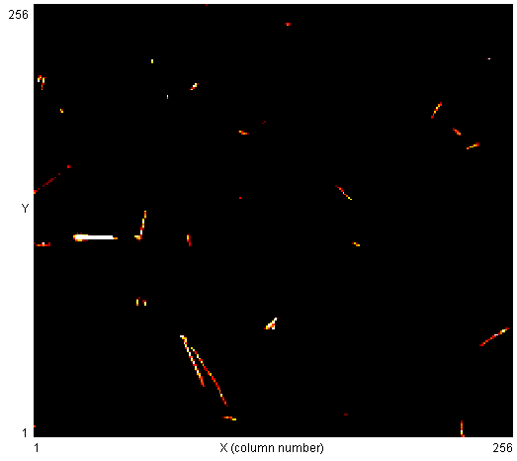
November 12th 2023
MX-10 t=300𝜇m
Heavy ionizing particles

Slide 15
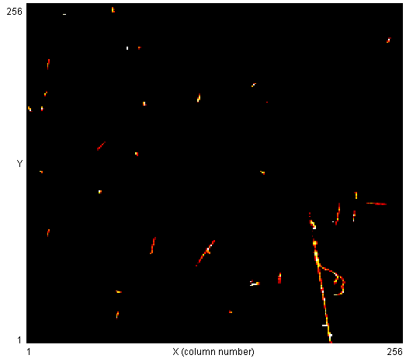
November 12th 2023
MX-10 t=300𝜇m
Multiple delta electrons
;-)

Slide 16
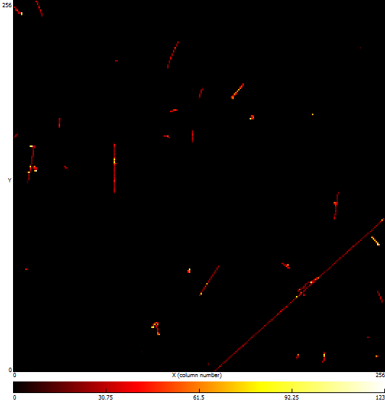
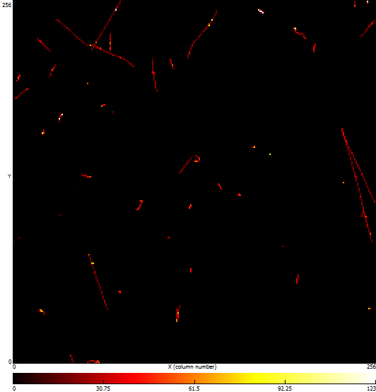
November 12th 2023
Advacam t=500𝜇m

Slide 17
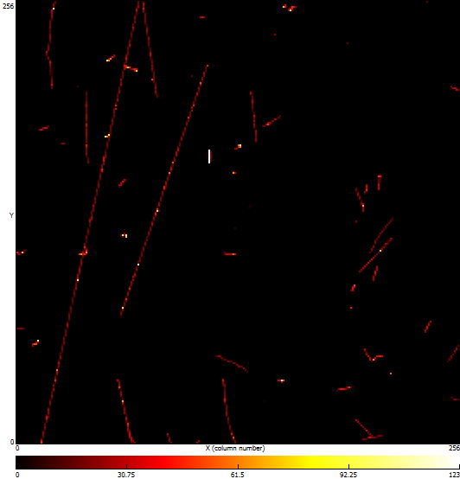
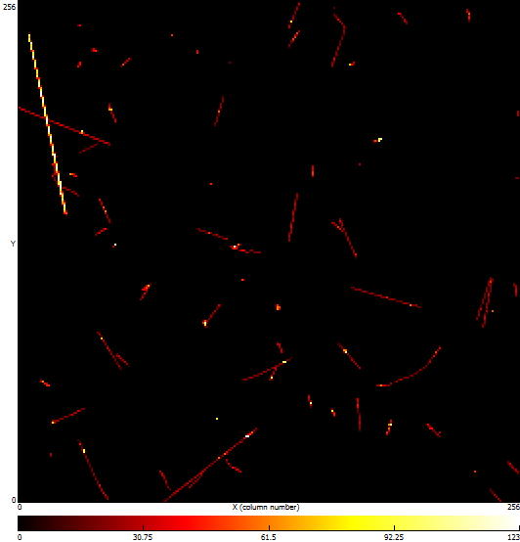
November 12th 2023
Advacam t=500𝜇m
Long muon track segments
A pion?

Slide 18
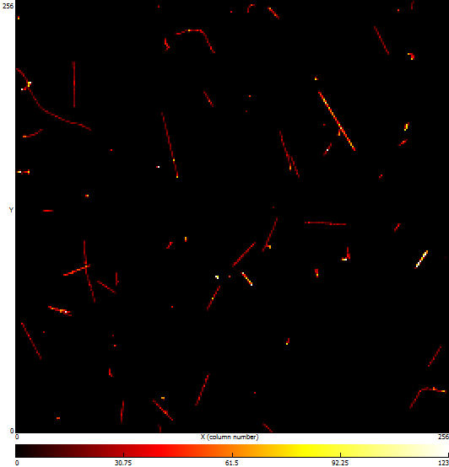
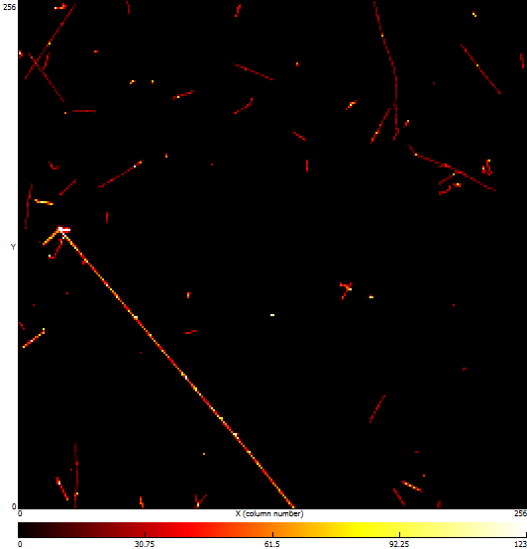
November 12th 2023
Advacam t=500𝜇m
A nuclear interaction, pions production?

Slide 19
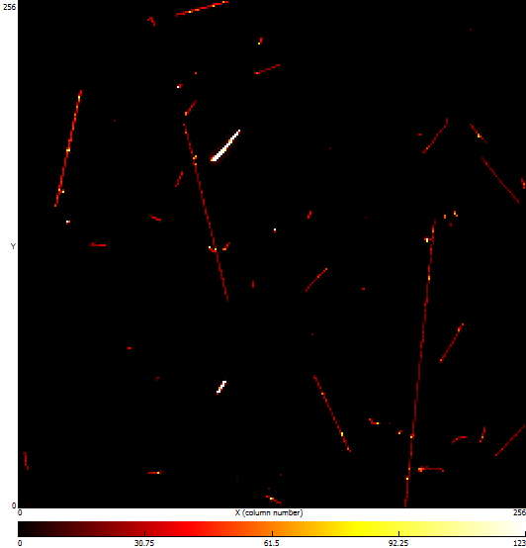
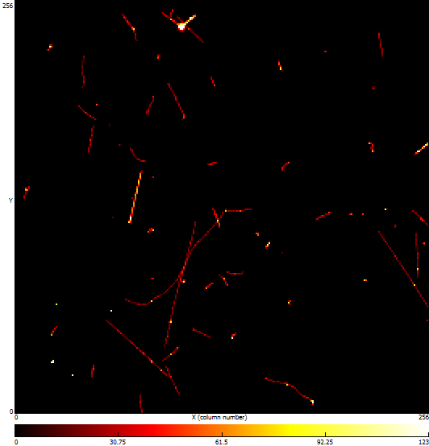
November 12th 2023
Advacam t=500𝜇m
Heavy ionizing particles

Slide 20
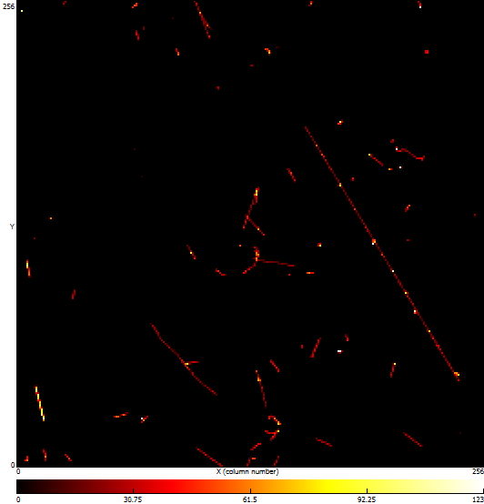

November 12th 2023
Advacam t=500𝜇m

Slide 21
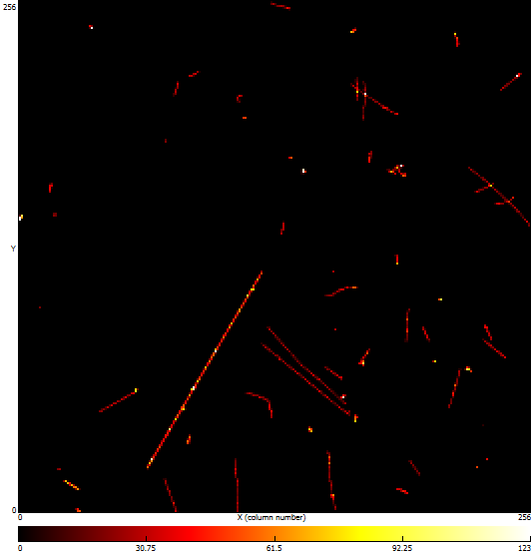
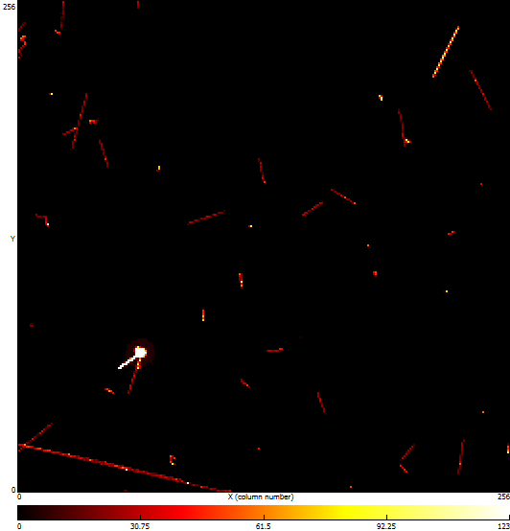
November 12th 2023
Advacam t=500𝜇m
Lots of energy here!

Slide 22
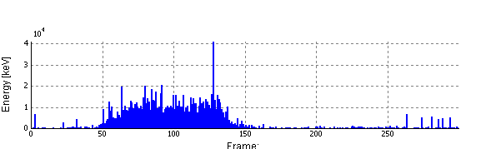
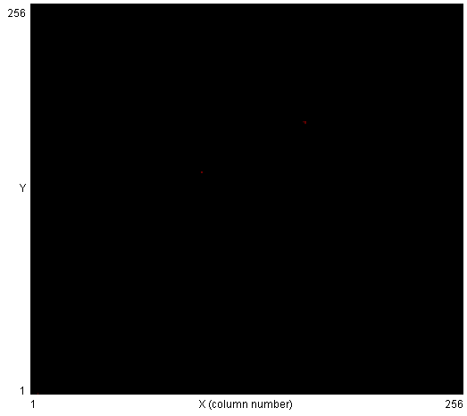
March 20th 2022
Advacam t=500𝜇m

Slide 23
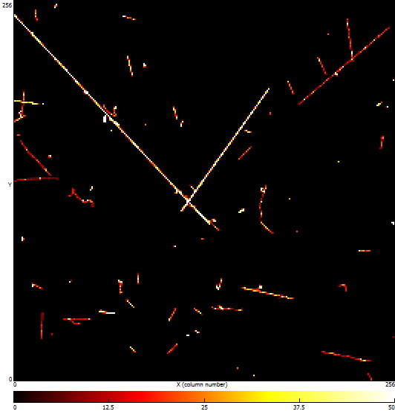
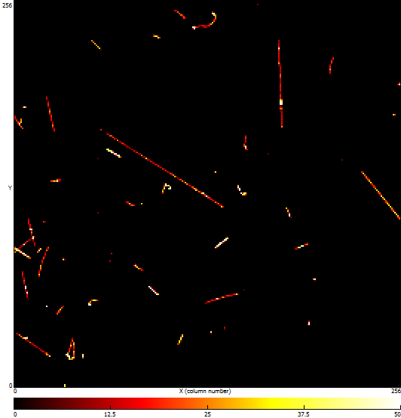
March 20th 2022
Advacam t=500𝜇m

Slide 24
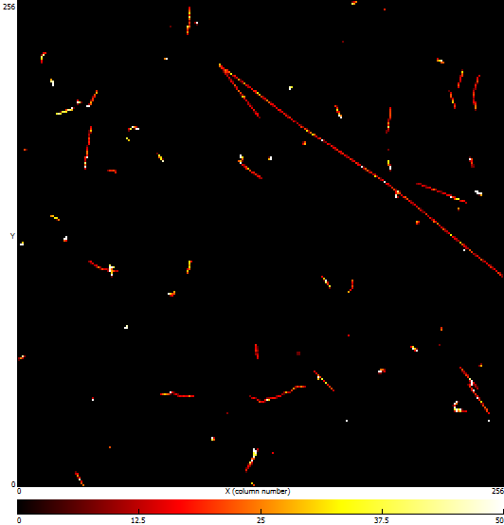
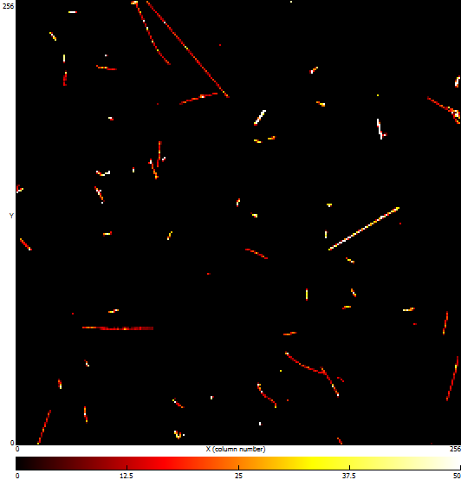
March 20th 2022
Advacam t=500𝜇m

Slide 25
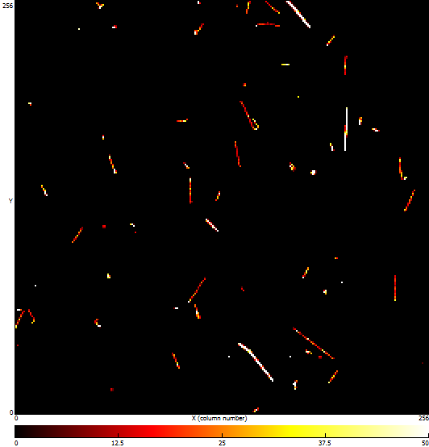
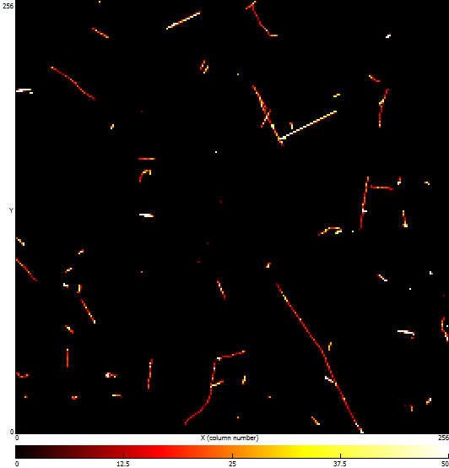
March 20th 2022
Advacam t=500𝜇m

Slide 26
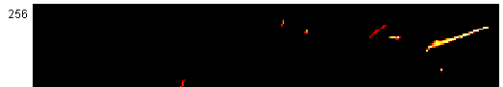
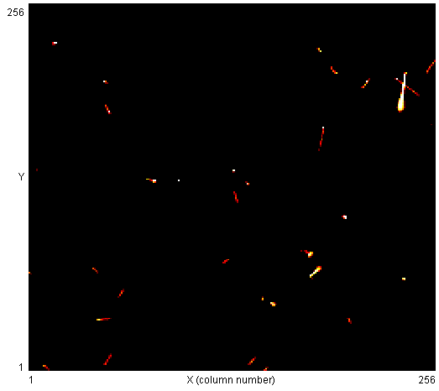
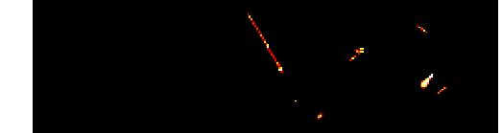


March 20th 2022
MX-10 t=300𝜇m

Slide 27


March 20th 2022
MX-10 t=300𝜇m

Slide 28



March 20th 2022
MX-10 t=300𝜇m

Slide 29



March 20th 2022
MX-10 t=300𝜇m

Slide 30


March 20th 2022
MX-10 t=300𝜇m

Slide 31


March 20th 2022
MX-10 t=300𝜇m

Slide 32



March 25th 2022
MX-10 t=300𝜇m

Slide 33


March 25th 2022
MX-10 t=300𝜇m

Slide 34


March 25th 2022
MX-10 t=300𝜇m

Slide 35


March 25th 2022
MX-10 t=300𝜇m

Slide 36


March 25th 2022
MX-10 t=300𝜇m

Slide 37


March 25th 2022
MX-10 t=300𝜇m

Slide 38


March 25th 2022
MX-10 t=300𝜇m

Slide 39

March 25th 2022
MX-10 t=300𝜇m

Slide 40

July 24th 2022
Advacam t=500𝜇m

Slide 41


July 24th 2022
Advacam t=500𝜇m

Slide 42


July 11th 2022
Advacam t=500𝜇m

Slide 43


July 11th 2022
Advacam t=500𝜇m

Slide 44


July 11th 2022
Advacam t=500𝜇m

Slide 45


July 11th 2022
Advacam t=500𝜇m
https://www.daviddarling.info/encyclopedia/P/pion.html
Stopped muon? Even decayed?

Slide 46


July 11th 2022
Advacam t=500𝜇m
Stopped muon? Even decayed?
https://www.daviddarling.info/encyclopedia/P/pion.html

Slide 47


Apr 2018
MX-10 t=300𝜇m

Slide 48


16th Apr 2018
MX-10 t=300𝜇m

Slide 49


16th Apr 2018
MX-10 t=300𝜇m

Slide 50


20th Apr 2018
MX-10 t=300𝜇m

Slide 51


20th Apr 2018
MX-10 t=300𝜇m

Slide 52


20th Apr 2018
MX-10 t=300𝜇m

Slide 53


Munchen Peking Sept2019
MX-10 t=300𝜇m

Slide 54


Peking Vienna Sept2019
MX-10 t=300𝜇m

Slide 55


Muc Pek Sept2019
MX-10 t=300𝜇m

Slide 56


Muc Pek Sept2019
MX-10 t=300𝜇m

Slide 57


Muc Pek Sept2019
MX-10 t=300𝜇m

Slide 58


Muc Pek Sept2019
MX-10 t=300𝜇m

Slide 59


Muc Pek Sept2019
MX-10 t=300𝜇m
Stopped muon again?

Slide 60

Muc Pek Sept2019
MX-10 t=300𝜇m

Slide 61


Pek Vie Sept2019
MX-10 t=300𝜇m

Slide 62


Pek Vie Sept2019
MX-10 t=300𝜇m

Slide 63


Pek Vie Sept2019
MX-10 t=300𝜇m

Slide 64


Pek Vie Sept2019
MX-10 t=300𝜇m

Slide 65


Pek Vie Sept2019
MX-10 t=300𝜇m

Slide 66


Pek Vie Sept2019
MX-10 t=300𝜇m

Slide 67


Pek Vie Sept2019
MX-10 t=300𝜇m

Slide 68


Pek Vie Sept2019
MX-10 t=300𝜇m

Slide 69


Pek Vie Sept2019
MX-10 t=300𝜇m

